Slide 1
The Technology Value Stream
Cuitlahuac Hernandez
CSD-380
June 1, 2025

Slide 2
Introduction to the Technology Value Stream
A value stream represents the series of steps taken to deliver a product or service to a customer.
In the technology realm, it includes all stages of software development and delivery, from idea generation to deployment.
Focuses on maximizing efficiency and reducing waste in the process.

Slide 3
Lead Time vs. Processing Time
Lead Time: Total time from a customer request to delivery. Includes both active work and waiting time.
Processing Time: The time actively spent working on a task or project.
Key Insight: Reducing lead time significantly improves customer satisfaction and time-to-market.

Slide 4
Common Scenario: Deployment Lead Times Requiring Months
Many organizations face deployment lead times measured in months.
Causes:
Manual approvals
Limited automation
Bottlenecks in processes
Cultural resistance to change
Impact:
Slower feedback loops
Increased risk of errors
Reduced competitiveness

Slide 5
Our DevOps Ideal: Deployment Lead Times of Minutes
DevOps Approach:
Continuous Integration/Continuous Deployment (CI/CD) pipelines.
Automated testing and monitoring.
Streamlined collaboration between development and operations teams.
Result:
Lead times reduced to minutes.
Faster feedback and iteration cycles.
Higher quality and more reliable software delivery.

Slide 6
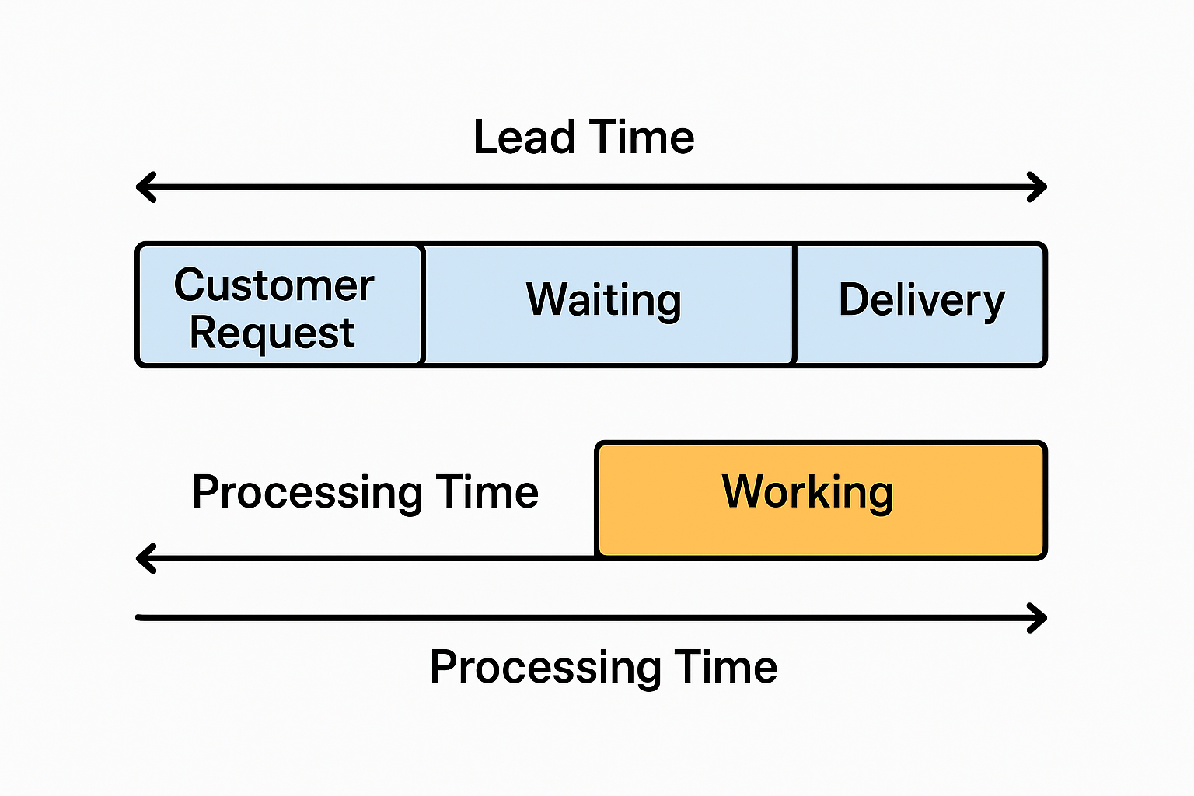
Graphic Slide: Lead Time vs. Processing Time

Slide 7
Conclusion
Summary:
Lead time and processing time are critical metrics for optimizing technology value streams.
Transitioning from months-long to minutes-long deployment times is achievable through DevOps practices.
Final Thought:
Embracing DevOps not only accelerates delivery but also improves product quality and team morale.

